Slide 1
TITLE I Annual
Parent Meeting (Reunión Anual de Padres de Titulo I)
School/Escuela: Jim Thorpe ES
Date/Fecha: 8/8/2024
Time/Hora: 3:30 – 4:30 pm

Slide 2
Every Student Succeeds Act (ESSA) (La Ley-cada estudiante tenga exito ESSA por sus siglas en ingles)
Federal legislation passed to allow for the use of methods and instructional strategies to strengthen the academic program in the school, increase the amount and quality of learning, and help provide an enriched and accelerated curriculum, which may include programs, activities, and courses necessary to provide a well-rounded education.
La legislación federal aprobó permitir el uso de métodos y estrategias de enseñanza para fortalecer el programa académico en la escuela, aumentar la cantidad y la calidad del aprendizaje y ayudar a proporcionar un currículo enriquecido y acelerado, que pueden incluir programas, actividades y cursos necesarios para proporcionar una educación completa.

Slide 3
What is Title I? (¿Qué es Titulo I?)
Title I is a federally funded academic assistance program for schools.
(Titulo I - es un programa de fondos Federales para la asistencia académica de las escuelas.)
The goal of Title I is to ensure a high quality well-rounded education for every child. (La meta de Titulo I - es asegurar una alta educación de alta calidad para cada uno de los niños/as.)

Slide 4
WHAT DOES TITLE I PROVIDE AT MY CHILD’S SCHOOL?
(¿Qué es lo que Titulo I le provee a la escuela de mi hijo/a?)
Funds are used for: (Los fondos se utilizan para)
Class size reduction teacher x2
4th and 5th grade
3 CTTs

Slide 5
FOR SCHOOLS, ESSA: (ESSA Para Las Escuelas)
Ensures schools measure student progress using approved tests.
(Asegura que las escuelas midan el progreso de los estudiantes utilizando exámenes aprobados.)
Ensures schools issue reports charting school performance.
(Asegura que las escuelas distribuyan reportes del rendimiento escolar.)

Slide 6
FOR SCHOOLS, ESSA: (ESSA Para Las Escuelas)
Provides teacher training and professional development to improve instruction.
(Provee entrenamiento y capacitación profesional a los maestros para mejorar la enseñanza.)

Slide 7
For Students, ESSA: (ESSA Para Los Estudiantes)
Sets high expectations for academic achievement.
(Fija expectativas altas para el logro académico.)
Requires yearly testing for Grades 3-8 and High School.
(Requiere exámenes anualmente para los Grados 3ro al 8to y la preparatoria.)

Slide 8
For Students, ESSA: (ESSA Para Los Estudiantes)
Provides teachers who are licensed by the state of Nevada and use proven teaching methods.
(Provee maestros con licencia por el estado de Nevada los cuales utilizan métodos de enseñanza aprobados.)

Slide 9
Parents’ Rights and Responsibilities (Derechos de los padres y sus responsabilidades)
The right to receive periodic progress reports on the child and the school. (El derecho de recibir informes de progreso académico del niño/a y de la escuela periódicamente.)
The right to request information about the qualifications of their child’s teacher. (El derecho de solicitar información acerca de las credenciales del maestro de su hijo/a.)

Slide 10
The right to help decide if the school’s Title I program is meeting the needs of their child. (El derecho de ayudar a decidir si el programa de Titulo I dentro de la escuela esta llenando las necesidades de su hijo/a.)
The right to offer suggestions for academic improvement and increased parental involvement. (El derecho de ofrecer sugerencias para un mejoramiento académico y aumentar la participación de los padres.)

Slide 11
The responsibility to share information with the teacher about their child’s interests and abilities. (La responsabilidad de compartir información con el maestro tocante a los intereses y las habilidades del niño/a.)
The responsibility to attend parent conferences and to communicate regularly with the school concerning their child’s academic progress. (La responsabilidad de asistir a conferencias de padres y de comunicarse regularmente con la escuela acerca del progreso académico de sus niños.)

Slide 12
The responsibility to ensure their child attends school regularly, completes all homework and classroom assignments, and adheres to the District’s Educational Accord, Honor Code, and school behavior policies.
(La responsabilidad de asegurar que sus hijos asistan a la escuela regularmente, completen todas las tareas y en las del aula, y se adhiere al Acuerdo de la Educación del distrito, código de honor, y las normas de conducta en la escuela.)

Slide 13
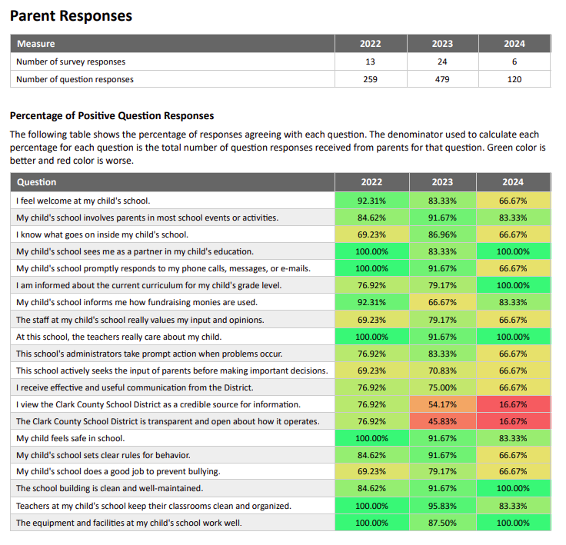
Districtwide Survey results
(Los resultados del estudio del?)
Last year’s survey results

Slide 14
Parent And Family
Engagement Policy (la Póliza de Participación de Padres de la escuela?)
Let’s review the Parent and Family Engagement Policy currently in place.
(Revisemos la Norma de Participación de los Padres actualmente implementada.)

Slide 15
Parent and Family Engagement Policy
Jim Thorpe Elementary School
2024 - 2025
1A. This Parent and Family Engagement Policy has been jointly developed and agreed upon by Jim Thorpe Elementary School Leadership Team, school staff, and the parents of students served in the school according to Title 1.
The Annual Parent Meeting will take place on Friday, August 9, 2024 to look at the school’s Title I budget plan, review the rights and responsibilities of parents, and to review and evaluate the Parent and Family Engagement Policy through Google meet. In an effort to increase attendance, this meeting will take place in the MPR before Meet and Greet. In addition, parents will have access to the PowerPoint through the link on the website. Parents will be notified via Dojo Class Story, Dojo School Story, Parentlink, and the school website. An initial meeting will be held with the School Organization TEAM (SOT) on May 15, 2024, and a second meeting will be held with the SOT on August 21, 2024, to make any necessary revisions to the family Engagement Policy. The PowerPoint from these meetings will be posted on the website for those who could not attend.
1B. The last District-wide Survey for parents was held in the 2023-2024 school year. The district’s pledge of Achievement had goals to increase the numbers of parents agreeing and strongly agreeing with the following statements: “I feel informed about the current curriculum for my child’s grade level”, this increased from 79% to 100%! “The teachers really care about my child at this school” the survey went from 91% to 100%.
Results are used to develop the Parent and Family Engagement Plan. To increase the percentage of parents agreeing with feeling informed about the school, including the statement of the parents feeling welcomed, the following will take place:
Go Guardian will be used to monitor students online by the classroom teachers, administrators, social worker, and counselor.
The counselor, school social worker, and learning strategists will make home visits as needed.
Safe Voice will continue to be posted on the school website.
Monthly Spirit days will be used to get students excited about school.
Daily morning announcements videos, where students say the pledge, will be posted at the beginning of class.
The Facebook page, Instagram, and Twitter will be updated to include celebrations, updates, and open it up for comments.
A Staff Family Engagement Team will meet at least once a month to discuss fundraisers and student/parent activities.
Food/ snacks will be provided at SOT meetings and other family involvement events
Teachers will use class dojo to communicate with families what is happening in the classroom, our goal is to have 100% of families on Class Dojo for regular 2-way communication.

Slide 16
1B. the last District-wide Survey for parents was held in the 2022-2023 school year. The district’s pledge of Achievement had goals to increase the numbers of parents agreeing and strongly agreeing with the following statements: Happy with the school and Student Safety. For the statement “Student Safety” Parents said they agree 91%! Most parents continue to agree that at the school teachers really care about their children (91% of agreement). The statement in which there was the largest increase of parents agreeing, with a total of 87%, was “I know what goes on at my student’s school”, as compared to 69% previously. In the area of “This school actively seeks the input of parents before making decisions” increased from 69% to 79%.
Results are used to develop the Parent and Family Engagement Plan. To increase the percentage of parents agreeing with feeling informed about the school, including the statement of the parents feeling welcomed, the following will take place:
Go Guardian will be used to monitor students online by the classroom teachers, administrators, social worker, and counselor.
The counselor, school social worker and learning strategists will make home visits as needed.
Safe Voice will continue to be posted on the school website.
Monthly Spirit days will be used to get students excited about school.
Daily pledge videos, where students say the pledge, will be posted at the beginning of class.
The Facebook page, Instagram and Twitter will be updated to include celebrations, updates, and open it up for comments.
A Staff Family Engagement Team will meet at least once a month to discuss fundraisers and student/parent activities.
CCSD COVID Guidelines will be followed
Food/ snacks will be provided at SOT meetings, and other family involvement events
Teachers will use class dojo to communicate with families what is happening in the classroom, our goal is to have 100% of families on Class Dojo for regular 2 way communication.
Other than sharing Thorpe’s Parent and Family Engagement Policy at the meet and greet, a second and third meeting will be held with the SOT to review the policy and make changes if necessary. The Parent and Family Engagement Policy will be made available to the community through the school office and website. To increase participation in the CCSD Parent Survey, information is sent through ClassDojo, Parentlink and the school website and is distributed in an understandable and uniform format and in a language parents can understand. Information will be sent to families informing them of the availability of computers in the school to complete the District Survey. The survey will be reviewed at that Annual Title 1 parent meeting. 2. Jim Thorpe Elementary School will involve parents in an organized, ongoing, and timely manner by inviting them to join in the planning, review, and improvement of the Title 1 programs, School Performance Plan, and Parent and Family Engagement Policy. A parent representative is part of the school planning team. Monthly SOT meetings will take place to review the school goals and Title I implementation plan. The SOT agenda is posted on our ClassDojo, Parent link, and the school website at least 3 days before the meeting and a time for public comment is always added to the agenda. In addition, during the SOT voting period for parent representatives, information is sent multiple times on ClassDojo.
3. The Educational Involvement Accord is integrated into the registration process through Infinite Campus. Parents must review the Accord prior to completing their child's registration. Administrators and teachers will have access to the Accord whenever needed for parent/student conferences or other occasions.

Slide 17
Other than sharing Thorpe’s Parent and Family Engagement Policy at the meet and greet, a second and third meeting will be held with the SOT to review the policy and make changes if necessary. The Parent and Family Engagement Policy will be made available to the community through the school office and website. To increase participation in the CCSD Parent Survey, information is sent through ClassDojo, Parentlink, and the school website and is distributed in an understandable and uniform format and in a language parents can understand. Information will be sent to families informing them of the availability of computers in the school to complete the District Survey. The survey will be reviewed at that Annual Title 1 parent meeting. 2. Jim Thorpe Elementary School will involve parents in an organized, ongoing, and timely manner by inviting them to join in the planning, review, and improvement of the Title 1 programs, School Performance Plan, and Parent and Family Engagement Policy. A parent representative is part of the school planning team. Monthly SOT meetings will take place to review the school goals and Title I implementation plan. The SOT agenda is posted on our ClassDojo, Parent link, and the school website at least 3 days before the meeting and a time for public comment is always added to the agenda. In addition, during the SOT voting period for parent representatives, information is sent multiple times on ClassDojo.
3. The Educational Involvement Accord is integrated into the registration process through Infinite Campus. Parents must review the Accord before completing their child's registration. Administrators and teachers will have access to the Accord whenever needed for parent/student conferences or other occasions.
4A. Assistance will be provided to parents in understanding such topics as the Nevada Academic Content Standards (NVACS), state and local assessments, requirements of Title 1, how to monitor their child’s academic progress, as well as how to work with school staff to improve the achievement of their child.
*Parents will participate throughout the year in parent/teacher conferences where the teacher explains how they can work with their child at home and how to monitor their child’s academic progress. Parents are informed about their child’s academic progress through monthly progress reports/classroom on Infinite Campus. Parents will be reminded to check Infinite Campus and technology assistance will be provided if needed by the school’s staff members. The content of the report is explained to parents during the Annual Parent Meeting and again during parent/teacher conferences, which are held the week of October 9, 2023, and throughout the year.
*Ongoing parent communication is provided through newsletters, fliers, Class Dojo, Parentlink, and phone calls. The communication includes information about the school curriculum, testing, school events, and tips on how parents can assist their child with classwork, homework, and school-related activities.
*Parents attend semester parent meetings to learn curriculum-based activities and strategies and receive needed supplies that they can use at home with their child.
4B. Jim Thorpe Elementary School hosts several parent trainings and activities. These events give parents additional information about the school curriculum and resources to use at home with their child that is aligned with the NVACS.
4C. In partnership with parents, the Read by Grade 3 Strategist and the school Social Worker will hold professional development activities to educate the staff on how to communicate effectively with parents and how to view parents as equal

Slide 18
partners in the education of their child, and how to implement and coordinate parent programs. Professional development will focus on:
The value and utility of contributions of parents
How to reach out to, communicate with, and work with parents as equal partners so they know what is happening in our school daily/ weekly.
Implementing and coordinating parent programs
Building ties between parents and the school
4D. All information related to school and parent programs and activities is sent home to parents via newsletters, the district’s phone communication system, ClassDojo, Parentlink, and the school website, and to the extent practicable, in a language that parents can understand.
4E. If allowed and safe, Jim Thorpe ES administration will coordinate and integrate feasible and appropriate parent involvement activities with the special education programs, community partnerships, and the Family Engagement Committee. Various grade levels also participate in activities through the Ronald McDonald House, Public Education Foundation, and Focus Schools Projects. In addition, parents participate in school family engagement activities such as Meet & Greet, PreK Family days, McDonald Night, Fall Festival (literacy night), Field Day, Ornament Night, Outstanding Olympian Ceremonies, The Fun Run, Craft Fair, and Book Fairs, Social Worker led parenting workshops.
4F. Parents are supported and given the opportunity to provide feedback and comments regarding parent involvement activities. Parent comments and requests, as well as parent concern forms, are elicited and responded to in a supportive and respected manner. Parent training evaluations are reviewed after each training. The counselor and social worker work as liaisons between the school and the families at Thorpe.

Slide 19
Thank you for attending (Gracias por Asistir)
For questions, please call:
Title I Services
Clark County School District
702-799-3850

